Slide 1
Chest X –Ray
Reading

Slide 2
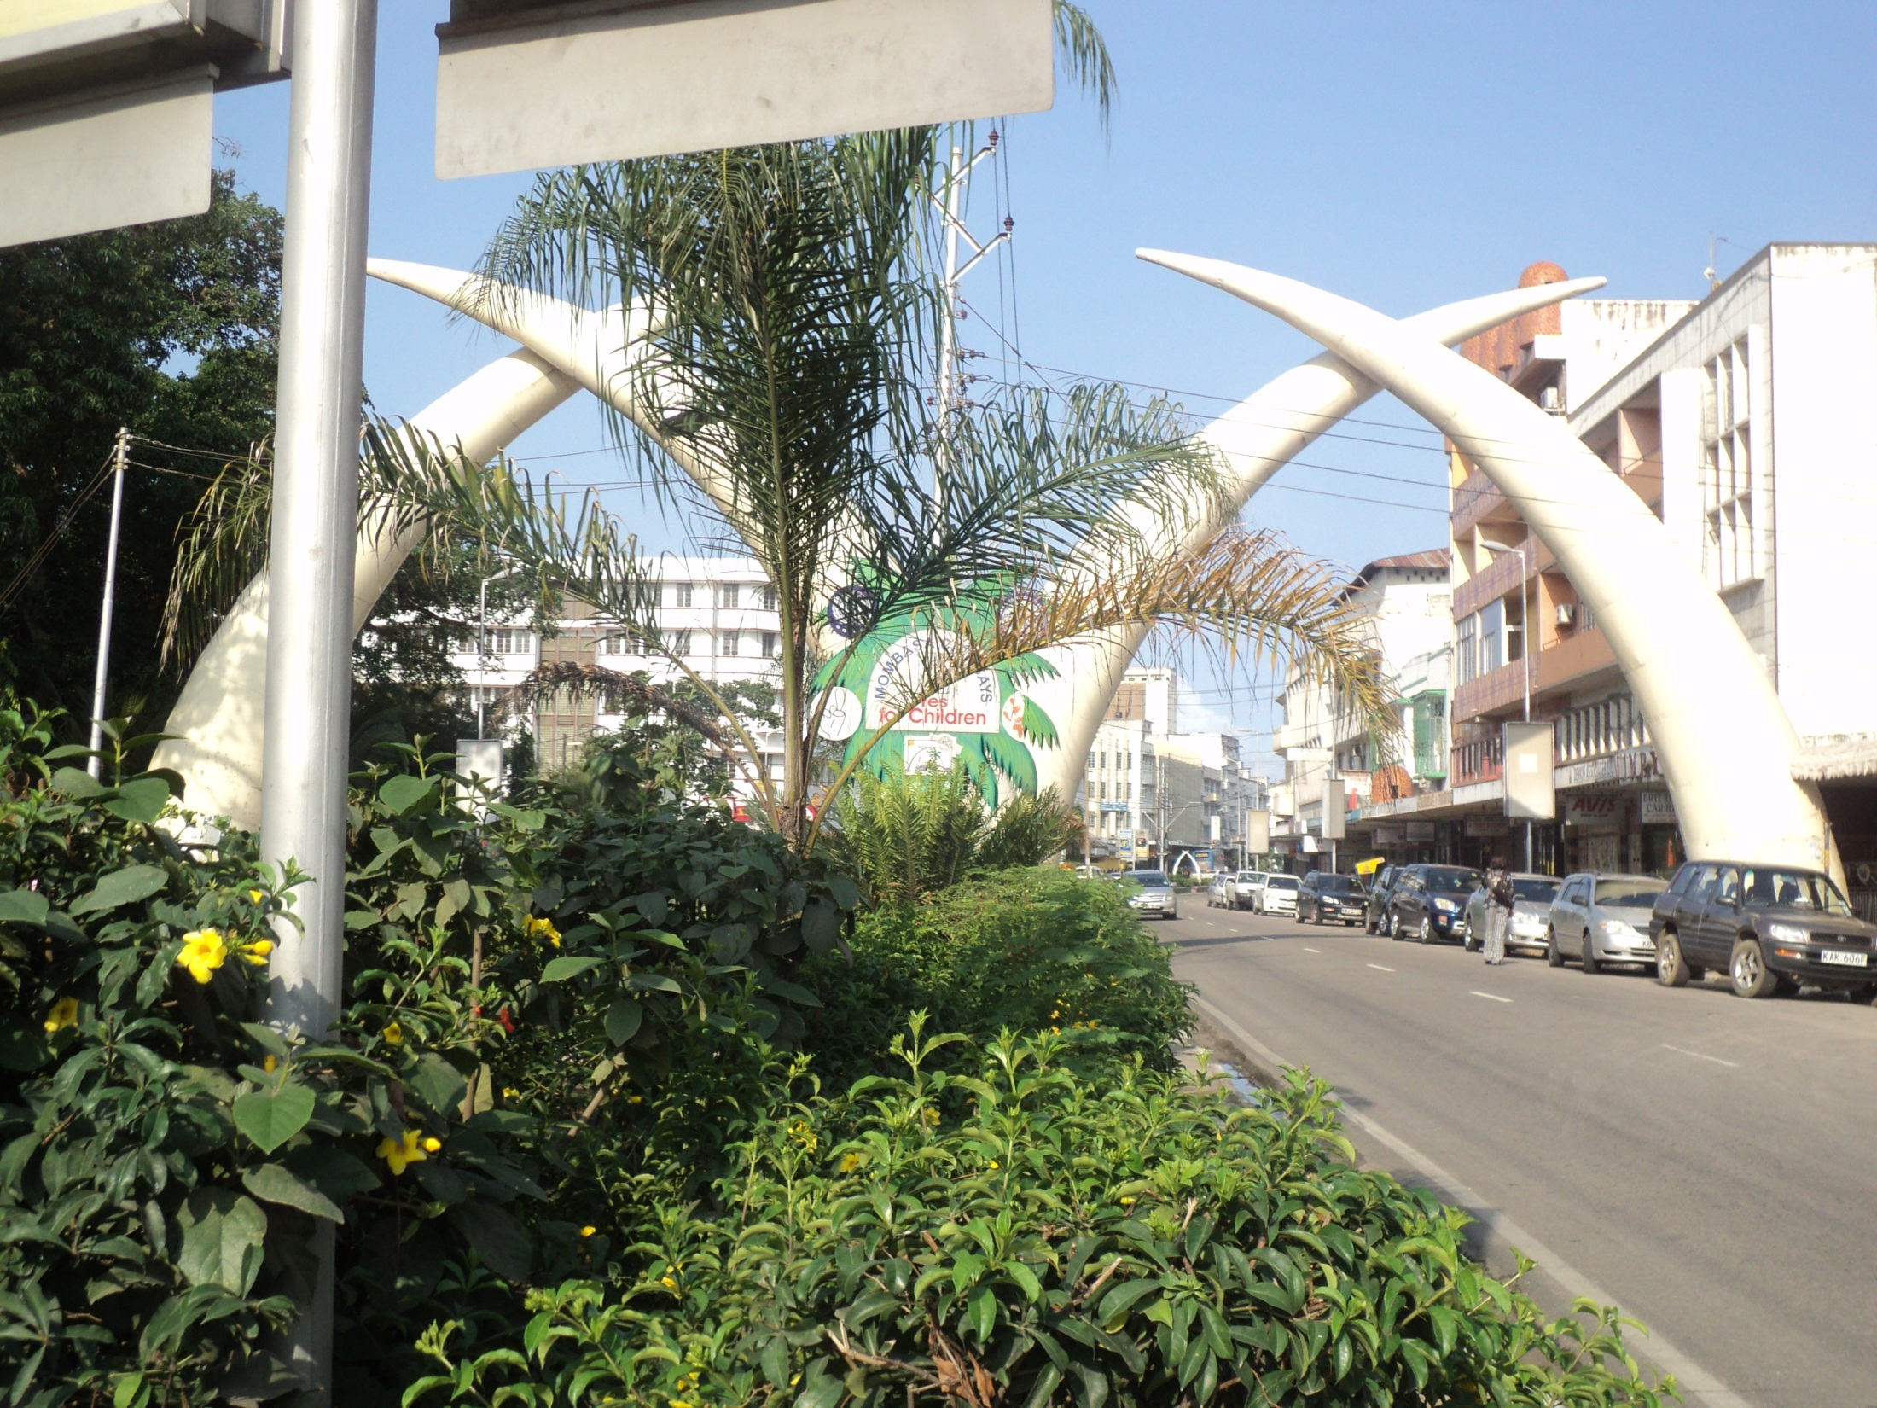

Slide 3
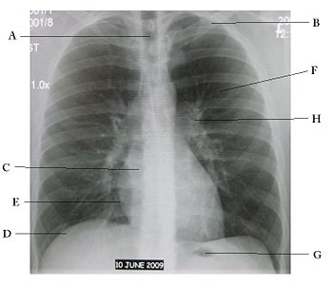
Normal chest x-ray.
A=Airway;
B=Bone,
C=Cardiac silhouette,
D=Diaphragm,
E=Edge of the heart,
F=Field of lung,
G=Gastric bubble,
H=Hilum of lung.

Slide 4
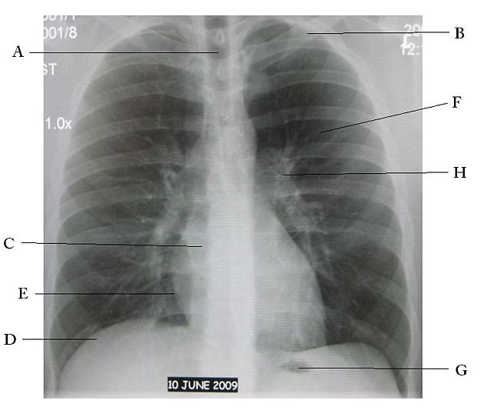

Slide 5
NOTE
The left side of the film represents the right side of the individual, and vice versa.
Air appears black, fat appears gray, soft tissues and water appear as lighter shades of gray, and bone and metal appear white.
The denser the tissue, the whiter it will appear on x-ray.
Denser tissues appear radiopaque, bright on the film; less dense tissues appear radiolucent, dark on the film.

Slide 6
1
Check the patient's name.
Above all else, make sure you are looking at the correct chest x-ray first.

Slide 7
2
Read the date of the chest radiograph.
Make special note of the date when comparing older radiographs (always look at older radiographs if available).
The date the radiograph is taken provides important context for interpreting any findings.
For example, a mass that has become bigger over 3 months is more significant than one that has become bigger over 3 years.

Slide 8
3
Note the type of film (while this article assumes you are looking at a chest x-ray, practice noting if it is a plain film, CT, angiogram, MRI, etc.)
For chest x-ray, there are several views as follows:
The standard view of the chest is the posteroanterior radiograph, or "PA chest."
Posteroanterior refers to the direction of the x-ray traversing the patient from posterior to anterior.
This film is taken with the patient upright, in full inspiration (breathed in all the way), and the x-ray beam radiating horizontally 6 feet away from the film.

Slide 9
The anteroposterior (AP) chest radiograph is obtained with the x-ray traversing the patient from anterior to posterior, usually obtained with a portable x-ray machine from very sick patients, those unable to stand, and infants.
Because portable x-ray units tend to be less powerful than regular units, AP radiographs are generally taken at shorter distance from the film compared to PA radiographs.

Slide 10
The farther away the x-ray source is from the film, the sharper and less magnified the image. (You can confirm this by placing your hand about 3 inches from a desk, shining a lamp above it from various distances, and observing the shadow cast.
The shadow will appear sharper and less magnified if the lamp is farther away.
Since AP radiographs are taken from shorter distances, they appear more magnified and less sharp compared to standard PA films.

Slide 11
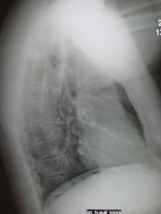
Lateral chest x-ray.

Slide 12
The lateral chest radiograph is taken with the patient's left side of chest held against the x-ray cassette (left instead of right to make the heart appear sharper and less magnified, since the heart is closer to the left side).
It is taken with the beam at 6 feet away, as in the PA view.
An oblique view is a rotated view in between the standard front view and the lateral view.
It is useful in localizing lesions and eliminating superimposed structures.

Slide 13
Right lateral decubitus chest x-ray
Right lateral decubitus chest x-ray showing pleural effusion.
The A arrow indicates "fluid layering" in the right chest.
The B arrow indicates the width of the right lung.
The volume of useful lung is reduced because of the collection of fluid around the lung.

Slide 14
A lateral decubitus view is one taken with the patient lying down on the side.
It helps to determine whether suspected fluid (pleural effusion) will layer out to the bottom, or suspected air (pneumothorax) will rise to the top.
For example, if pleural fluid is suspected in the left lung, check a left lateral decubitus view (to allow the fluid to layer to the left side).
If air is suspected in left lung, check a right lateral decubitus view (to allow the air to rise to the left side).

Slide 15
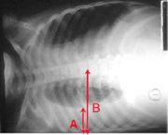

Slide 16
Look for markers: 'L' for Left, 'R' for Right, 'PA' for posteroanterior, 'AP' for anteroposterior, etc.
Note the position of the patient: supine (lying flat), upright, lateral, decubitus.

Slide 17
5
Note the technical quality of film.
Exposure: Overexposed films look darker than normal, making fine details harder to see; underexposed films look whiter than normal, and cause appearance of areas of opacification.
Look for intervertebral bodies in a properly penetrated chest x-ray. An under-penetrated chest x-ray cannot differentiate the vertebral bodies from the intervertebral spaces, while an over-penetrated film shows the intervertebral spaces very distinctly.
To assess exposure, look at the vertebral column behind the heart on the frontal view. If detailed spine and pulmonary vessels are seen behind the heart, the exposure is correct.
If only the spine is visible, but not the pulmonary vessels, the film is too dark (overexposed). If the spine is not visible, the film is too white (underexposed).

Slide 18
Motion: Motion appears as blurred areas. It is hard to find a subtle pneumothorax if there is significant motion.
Rotation: Rotation means that the patient was not positioned flat on the x-ray film, with one plane of the chest rotated compared to the plane of the film.
It causes distortion because it can make the lungs look asymmetrical and the cardiac silhouette disoriented.
Look for the right and left lung fields having nearly the same diameter, and the heads of the ribs (end of the calcified section of each rib) at the same location to the chest wall, which indicate absence of significant rotation.
If there is significant rotation, the side that has been lifted appears narrower and denser (whiter) and the cardiac silhouette appears more in the opposite lung field.

Slide 19
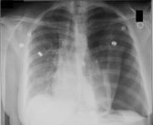
Left tension pneumothorax

Slide 20
Note the large, well-demarcated area devoid of lung markings, and deviation of the trachea (airway) and the heart away from the affected side.
The bright metallic spots are snaps for ECG readings.
Airway: Check to see if the airway is patent and midline.
For example, in a tension pneumothorax, the airway is deviated away from the affected side.
Look for the carina, where the trachea bifurcates (divides) into the right and left main stem bronchi.

Slide 21
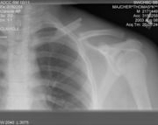
7 Bones

Slide 22
Bones: Check the bones for any fractures, lesions, or defects.
Note the overall size, shape, and contour of each bone, density or mineralization (osteogenic bones look thin and less opaque), cortical thickness in comparison to medullary cavity, trabecular pattern, presence of any erosions, fractures, lytic or blastic areas.

Slide 23
Look for lucent and sclerotic lesions. A lucent bone lesion is an area of bone with a decreased density (appearing darker); it may appear punched out compared to surrounding bone.
A sclerotic bone lesion is an area of bone with an increased density (appearing whiter).
At joints, look for joint spaces narrowing, widening, calcification in the cartilages, air in the joint space, abnormal fat pads, etc.

Slide 24
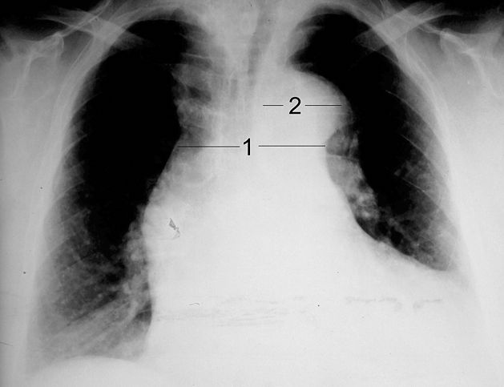
8. cardiac silhouette

Slide 25
Enlarged cardiac silhouette in a case of aortic dissection (blood fills the mediastinum). Note that the cardiac silhouette takes up more than half of the chest width. Characteristic of aortic dissection here is the enlarged mediastinum (labeled 1) and aortic arched (labeled 2).
Cardiac silhouette: Look at the size of the cardiac silhouette (white space representing the heart, situated between the lungs). A normal cardiac silhouette occupies less than half the chest width.
Look for water-bottle-shaped heart on PA plain film, suggestive of pericardial effusion. Get an ultrasound or chest Computed Tomagraphy (CT) to confirm.

Slide 26
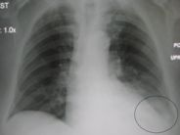
9. Left pleural effusion

Slide 27
Left pleural effusion associated with left lower lobe pneumonia: note that the costophrenic angle is blunted, and the left diaphragm is raised compared to the right.

Slide 28
10. Diaphragms: Look for a flat or raised diaphragm. A flattened diaphragm may indicate emphysema. A raised diaphragm may indicate area of airspace consolidation (as in pneumonia) making the lower lung field indistinguishable in tissue density compared to the abdomen. The right diaphragm is normally higher than the left, due to the presence of the liver below the right diaphragm.
Also look at the costophrenic angle (which should be sharp) for any blunting, which may indicate effusion (as fluid settles down). It takes about 300-500 ml of fluid to blunt the costophrenic angle.

Slide 29
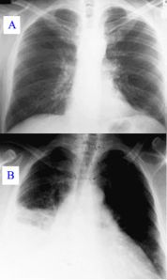

Slide 30
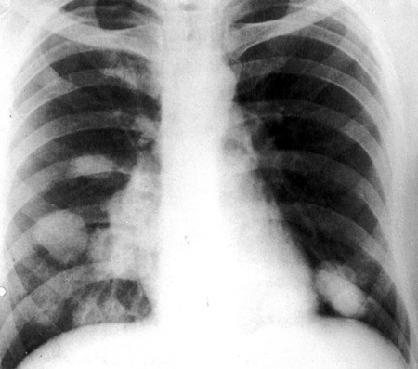
pulmonary metastasis cancer

Slide 31
A) Normal chest radiograph;
B) pneumonia affecting the lower and middle lobes of the right lung. Note the loss of the normal radiographic silhouette (contour) between the affected lung and its right heart border as well as between the affected lung and its right diaphragm border. This phenomenon is called the silhouette sign.

Slide 32
Edges of heart; External soft tissues: Check the edges of the heart for the silhouette sign: a radioopacity obscuring the heart's border, in right middle lobe and left lingula pneumonia, for example.
Also, look at the external soft tissues for any abnormalities.
Note the lymph nodes,
look for subcutaneous emphysema (air density below the skin), and other lesions.

Slide 33
Right lower lobe pneumonia. Note the prominent air-bronchogram sign: air visualized in the peripheral intrapulmonary bronchi, due to an infiltrate or consolidation surrounding the bronchi.

Slide 34
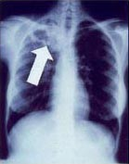
Pulmonary tuberculosis
  Lung, Primary Tuberculosis - focal opacity, consolidation, pleural effusion, lymphadenopathy, cavity, nodule.

Slide 35
11. Fields of the lungs: Look for symmetry, vascularity, presence of any mass, nodules, infiltration, fluid, bronchial cuffing, etc. If fluid, blood, mucous, or tumor, etc. fills the air sacs, the lungs will appear radiodense (bright), with less visible interstitial markings.

Slide 36
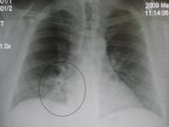
Right lower lobe pneumonia

Slide 37

Milliary tuberculosis

Slide 38

Milliary tuberculosis

Slide 39
12. Gastric bubble
Gastric bubble: Look for the presence of a gastric bubble, just below the heart; note whether it is obscured or absent.
Assess the amount of gas and location of the gastric bubble.
Normal gas bubbles may also be seen in the hepatic and splenic flexures of the colon.

Slide 40
13
Enlarged lymph node in left hilum, in a case of carcinoid tumor.
Hila: Look for nodes and masses in the hila of both lungs. On the frontal view, most of the hilar shadows represent the left and right pulmonary arteries. The left pulmonary artery is always more superior than the right, making the left hilum higher.
Look for calcified lymph nodes in the hilar, which may be caused by an old tuberculosis infection.

Slide 41
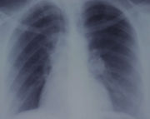
13. Enlarged lymph node

Slide 42
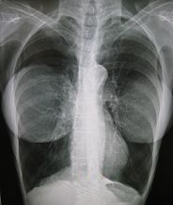
14. Instruments & Breast implants.

Slide 43
Instrumentations: Look for any tubes, IV lines, ECG leads, surgical drains, prosthesis, etc.

